Slide 1
UNIT 11
Project Management Concepts
教材
  英文精编版 第8版（第22章）

Slide 2
Contents & Requirements
Contents
  Knowledge point 1: The Management Spectrum
  Knowledge point 2: People, Product, Process, Project
  Knowledge point 3: Critical Practices
Requirements
  Understand the definition of software Quality Management
  Master the basic method of software quality control.

Slide 3
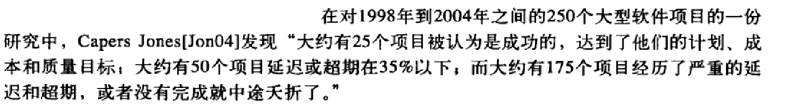
The Four P’s
People — the most important element of a successful project
  People-CMM
Product — the software to be built
  objectives, scope, solutions, constraints, cost, risk, tasks
  project schedule
Process — the set of framework activities and software engineering tasks to get the job done
  framework activity：action(a set of task)
    milestones, work products, and quality assurance points
  umbrella activities：software quality assurance, software
  configuration management, and measurement
Project — all work required to make the product a reality
Notes:
People ：项目成功最重要的因素
任何管理者，忘记软件工程是人的智力密集劳动，不可能在项目管理上取得成功
每个组织，都需提升：吸引、发展、激励、组织和留住人才，才能实现战略目标
人员配备、沟通与协调、工作环境、业绩管理、培训、报酬、能力与素质
分析与开发、个人事业发展、工作组发展、团队精神与企业文化
人员能力的成熟度模型，People—CMM
Product ：目标软件
若在项目开发早期没有鼓励利益相关者之间的广泛交流，就有为错误问题构造“良好”解决方案的风险
确定产品的目标和范围
目标：利益相关者协同，从利益相关者的角度给出项目的总体目标
范围：标识出产品的主要数据、功能和行为，以量化的方式界定这些特性
考虑可选的解决方案，识别技术和管理的限制
根据约束条件，确定最好的方案
产品交付期限、预算限制、可用人员、技术接口，及其他因素
合理的成本预算，有效的风险评估，适当的项目任务划分
项目的进度计划：给出意义明确的项目进展标志
Process ： 一系列框架活动和软件工程动作
对过程不在意，可能冒着把有效技术方法和工具插入到真空中的风险
框架活动中的任务集：因项目特征与团队需求，适当调整
普适性活动，独立于人的活动，贯穿于整个项目过程
Project ： 实现软件产品的所有工作
没有建立可靠项目计划就开始工作，将危及产品的成功
有计划，可控制，是项目成功的起点

Slide 4
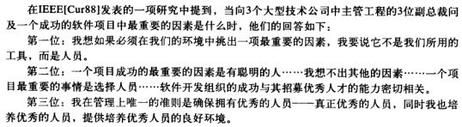
People
IEEE [Cur88]：what was the most important contributor to a successful software project. They answered in the following way:
  VP 1: I guess if you had to pick one thing out that is most important in our environment, I’d say it’s not the tools that we use, it’s the people.
  VP 2: The most important ingredient that was successful on this project was having smart people . . . very little else matters in my opinion. . . . The most important thing you do for a project is selecting the staff. . . . The success of the software development organization is very, very much associated with the ability to recruit good people.
  VP 3: The only rule I have in management is to ensure I have good people—real good people—and that I grow good people—and that I provide an environment in which good people can produce.
Notes:
----------------------------
但现实中，从总裁到基层，错觉：
人员不是问题，
虽然这3位，如此表态，但
现实中可能言行不一

Slide 5
People — Stakeholders
Senior managers who define the business issues that often have significant influence on the project.
Project (technical) managers who must plan, motivate, organize, and control the practitioners who do software work.
Practitioners who deliver the technical skills that are necessary to engineer a product or application.
Customers who specify the requirements for the software to be engineered and other stakeholders who have a peripheral interest in the outcome.
End-users who interact with the software once it is released for production use.
Notes:
People——利益相关者
高级管理者：负责定义业务问题，对项目影响很大
项目（技术）管理者：计划、激励、组织和控制软件开发人员
开发人员：开发技能
客户：阐明需求、关心项目成败
最终用户：一旦软件发布成为产品，最终用户就是直接与软件交互的人。
团队负责人的任务：组织
为了提高效率，项目团队必须最大限度地发挥每个人的技术和能力

Slide 6

People — Software Teams
How to lead?
How to organize?
How to collaborate?
How to motivate?
How to create good ideas?
Notes:
----------------------------
领导、协作、激励、组织、思想或创新（领导能力的MOI模型）

Slide 7
People — Team Leader
The MOI Model
  Motivation. The ability to encourage (by “push or pull”) technical people to produce to their best ability.
  Organization. The ability to mold existing processes (or invent new ones) that will enable the initial concept to be translated into a final product.
  Ideas or innovation. The ability to encourage people to create and feel creative even when they must work within bounds established for a particular software product or application.
Notes:
People——团队领导
----------------------------
胜任开发的人往往是拙劣的团队负责人，他们完全不具备管理人员的技能。
软件项目负责人的技能？——Jerry Weinberg[Wei86]提出了领导能力的MOI模型
Motivation（激励）：鼓励技术人员发挥最大才能的一种能力
Organization（组织）：形成能够将最初概念转换成最终产品的现有过程（或创造新过程）的能力。
Ideas or Innovation（思维或创新）：
即使必须在特定软件产品或应用系统的约束下工作
也能鼓励人们去创造并让人感到有创造性的一种能力。
换句话说一个具有实战能力的项目经理需具备4种关键品质：

Slide 8
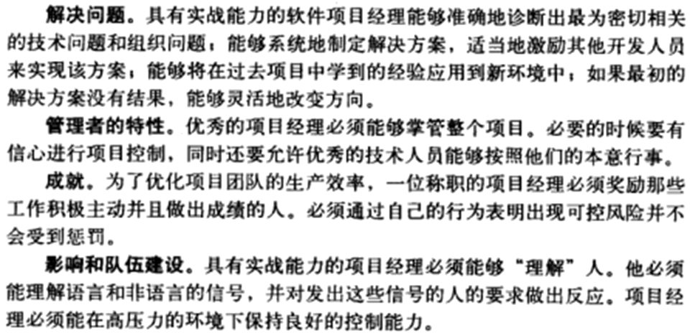
People — Team Leader
an effective project manager emphasizes four key traits:
Notes:
People——团队领导
----------------------------
一个具有实战能力的项目经理，需具备4种关键品质：
解决问题
诊断技术问题和组织问题，在新问题中，能利用经验
制定解决方案，方案不成功，能灵活改变方向
激励员工实现方案
管理者特性
掌控项目
发挥员工的主管能动性
成就
奖励
出现可控风险，不受惩罚
影响和建设队伍
有实战能力的项目经理：理解人
语言和非语言符号
高压下良好的控制能力

Slide 9
People — Software Teams
The following factors must be considered when selecting a software project team structure ...
the difficulty of the problem to be solved
the size of the resultant program(s) in lines of code or function points
the time that the team will stay together (team lifetime)
the degree to which the problem can be modularized
the required quality and reliability of the system to be built
the rigidity of the delivery date
the degree of sociability (communication) required for the project
Notes:
People——软件团队：组队因素
----------------------------
选择软件团队的结构时，应该考虑什么因素？
“最好的”团队结构取决于：组织的管理风格，团队的人员数目与技能水平，以及问题的总体难易程度。
→ 待解决问题的难度。
→ 开发程序的规模，以代码行或者功能点来度量。
→ 团队成员需要共同的工作时间（团队生存期）。
→ 能够对问题做模块化划分的程度。
→ 待开发系统的质量要求和可靠性要求。
→ 交付日期的严格程度。
→ 项目所需的友好交流的程度。

Slide 10
People — Software Teams
“organizational paradigms” for software engineering teams：
closed paradigm—structures a team along a traditional hierarchy of authority
random paradigm—structures a team loosely and depends on individual initiative of the team members
open paradigm—attempts to structure a team in a manner that achieves some of the controls associated with the closed paradigm but also much of the innovation that occurs when using the random paradigm
synchronous paradigm—relies on the natural compartmentalization of a problem and organizes team members to work on pieces of the problem with little active communication among themselves
Notes:
确定团队结构时，有哪些选择(4种组织范型)？
封闭式范型：最早的范型——主程序员团队
高级工程师（主程序员），计划、协调和评审所有的技术工作
多人配合主程序员的工作：行业专家，数据库设计员、文秘、行政人员、软件资料员
技术人员：2~5，分析和开发
后备工程师：支持高级工程师，以最小代价接替高级工程师的工作
随机式范型：主程序员团队结构的变种
独立创新性，自由的工作方式
信任、凝聚力
强调团队成员的技能分布
开放式范型
同步式范型

Slide 11
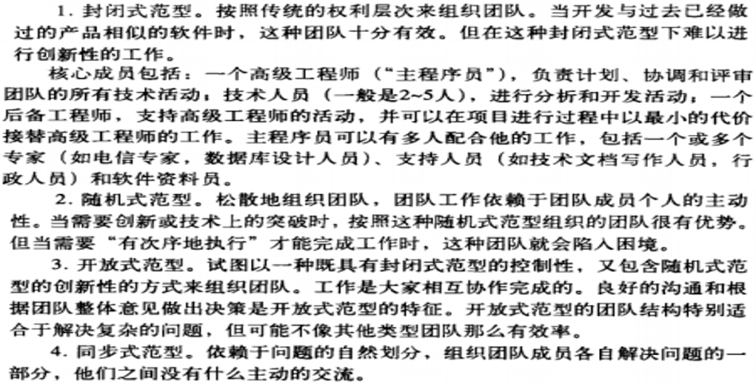
People——Software Teams
“organizational paradigms” for software engineering teams：
closed paradigm—structures a team along a traditional hierarchy of authority
random paradigm—structures a team loosely and depends on individual initiative of the team members
open paradigm—attempts to structure a team in a manner that achieves some of the controls associated with the closed paradigm but also much of the innovation that occurs when using the random paradigm
synchronous paradigm—relies on the natural compartmentalization of a problem and organizes team members to work on pieces of the problem with little active communication among themselves

Slide 12
People — Software Teams
Avoid Team “Toxicity”
A frenzied work atmosphere in which team members waste energy and lose focus on the objectives of the work to be performed.
High frustration caused by personal, business, or technological factors that cause friction among team members.
“Fragmented or poorly coordinated procedures” or a poorly defined or improperly chosen process model that becomes a roadblock to accomplishment.
Unclear definition of roles resulting in a lack of accountability and resultant finger-pointing.
“Continuous and repeated exposure to failure” that leads to a loss of confidence and a lowering of morale.
Notes:
People——软件团队
----------------------------
Jackman [Jac98]定义了：
影响团队凝聚力的5个“团队毒性”因素
→ 狂乱的工作氛围
→ 引起团队成员间产生摩擦的重大挫折
→ “碎片式的或协调很差”的软件过程
→ 在软件团队中没有清晰的角色定义
→ “接连不断地重蹈覆辙”

Slide 13
People — Agile Teams
Team members must have trust in one another.
The distribution of skills must be appropriate to the problem.
Mavericks may have to be excluded from the team, if team cohesiveness is to be maintained.
Team is “self-organizing”
  An adaptive team structure
  Uses elements of Constantine’s random, open, and synchronous paradigms
  Significant autonomy
Notes:
People——敏捷团队
----------------------------
敏捷方法学的倡导是：
通过尽早地交付软件来使顾客满意；
组织小型的充满活力的项目团队；
采用非正式的方法；
交付最小的软件工程工作产品；
以及总体开发简易性。
团队成员必须互相信任
团队成员的技能分布必须适合于要解决的问题
如果要保持团队的凝聚力，必须将坚持个人己见的人员排除于团队之外
团队是 “自组织的”
自适应团队结构
使用Constantine提出的随机、开放和同步式的范型
相当大的自主权

Slide 14
People — Team Coordination & Communication
Formal, impersonal approaches
  include software engineering documents and work products (including source code), technical memos, project milestones, schedules, and project control tools (Chapter 23), change requests and related documentation, error tracking reports, and repository data (see Chapter 26).
Formal, interpersonal procedures
  focus on quality assurance activities (Chapter 25) applied to software engineering work products. These include status review meetings and design and code inspections.
Informal, interpersonal procedures
  include group meetings for information dissemination and problem solving and “collocation of requirements and development staff.”
Electronic communication
  encompasses electronic mail, electronic bulletin boards, and by extension, video-based conferencing systems.
Interpersonal networking
  includes informal discussions with team members and those outside the project who may have experience or insight that can assist team members.
Notes:
People ——协作与沟通
----------------------------
正式的，客观的方法
包括软件工程文档和工作产品 (包括源代码)，技术日志，项目里程碑，日程安排表和项目控制工具，变更要求和相关的文档 ，错误跟踪报告和存储库数据
正式的交流机制
将目光集中在应用于软件工程工作产品的质量保证活动。这些活动包括状态审查会、设计和代码检查。
非正式的交流机制
包括信息传递的团队会议、问题解决和 “需求的搭配和开发人员”。
电子交流
包括电子邮箱，电子公告板，相关地，还有视频会议系统。
人际网络
包括与团队成员进行非正式讨论，那些没有参与工程的有经验或见解的人可以协助团队成员。

Slide 15

Product
You must examine the product and the problem it is intended to solve at the very beginning of the project.
At a minimum, the scope of the product must be established and bounded.
Notes:
Product
----------------------------
从项目一开始，就要研究应该开发哪些产品，以及要解决哪些问题。
至少我们要建立和界定产品的范围。

Slide 16

Product — Scope
Software project scope must be unambiguous and understandable at the management and technical levels.
Context. How does the software to be built fit into a larger system, product, or business context and what constraints are imposed as a result of the context?
Information objectives. 1) What customer-visible data objects are produced as output from the software? 2) What data objects are required for input?
Function and performance. 1) What function does the software perform to transform input data into output? 2) Are any special performance characteristics to be addressed?
Notes:
Product——范围
----------------------------
软件项目范围在管理层和技术层都必须是无歧义的和可理解的：
项目环境
要开发的软件，如何适应于大型的系统、产品或业务环境，该环境下要施加什么约束?
信息目标
软件要产生哪些客户可见的数据对象作为输出?
需要什么数据对象作为输入?
功能和性能
软件要执行什么功能，才能将输入数据变换成输出数据?
软件需要满足什么特殊的性能要求?

Slide 17
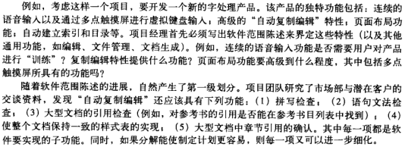
Product — Problem Decomposition
Sometimes called partitioning or problem elaboration
Once scope is defined …
  It is decomposed into constituent functions
  It is decomposed into user-visible data objects or It is decomposed into a set of problem classes
Decomposition process continues until all functions or problem classes have been defined
Notes:
Product——问题分解
----------------------------
有时称为 问题划分 或 问题细化
一旦范围被定义 ……
它被分解成一系列功能
它被分解成用户可见的数据对象 或 它被分解成一系列问题类
分解过程一直进行直到所有功能或问题类都定义

Slide 18
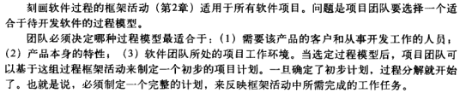
Process
Once a process framework has been established
  Consider project characteristics
  Determine the degree of rigor required
  Define a task set for each software engineering activity
    Task set =
      Software engineering tasks
      Work products
      Quality assurance points
      Milestones
Notes:
Process：选取适于项目的过程模型
----------------------------
一旦过程框架被建立
考虑产品本身的特性
确定产品严格要求的程度
为每一个软件工程活动定义一个任务集
任务集 =
软件工程任务
工作产品
质量保证点
里程碑

Slide 19
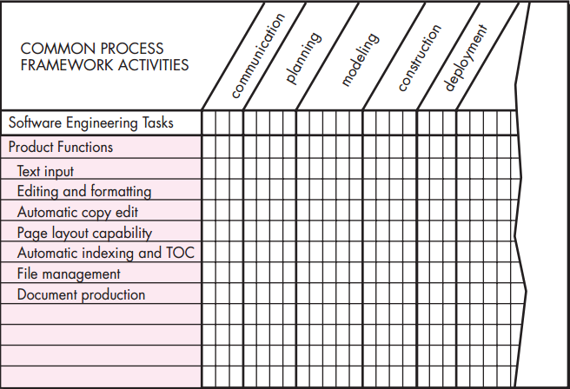
Process —
Melding the Problem and the Process
Project planning begins with the melding of the product and the process.
The job of the project manager (and other team members) is：
to estimate resource requirements for each matrix cell
start and end dates for the tasks associated with each cell
work products to be produced as a consequence of each task
Notes:
Process——合并产品与过程
----------------------------
项目计划开始于产品和过程的合并
团队要完成的每一项功能，都必须针对软件组织而定义的一系列框架活动来完成
项目经理以及其他成员的工作：
估算每个矩阵单元的资源请求
与每个单元相关的任务的起止日期
每项任务所产生的工作产品

Slide 20
Process——Decomposition
A software team should have a significant degree of flexibility in choosing the software process model that is best for the project and the software engineering tasks that populate the process model once it is chosen.
Once the process model has been chosen, the process framework is adapted to it.
  The process framework is invariant, but actual work tasks do vary.
  Process decomposition commences when the project manager asks: “How do we accomplish this framework activity?”
Notes:
Process——过程分解
----------------------------
选定过程模型：项目团队可根据需要，灵活确定过程模型应包含的软件工程任务
可根据项目规模，采用：
线性顺序方法（规模小且做过类似项目）
增量策略（时间紧）
其他过程模型
根据过程模型对过程框架做适应性修改。
虽然过程框架不变，但实际任务在完成规模和复杂性不同的框架活动时是不同的。同样的框架活动可分解为不同的任务序列。
当项目经理问道： “我们如何完成这个框架活动”时，就意味着过程分解就开始了…

Slide 21
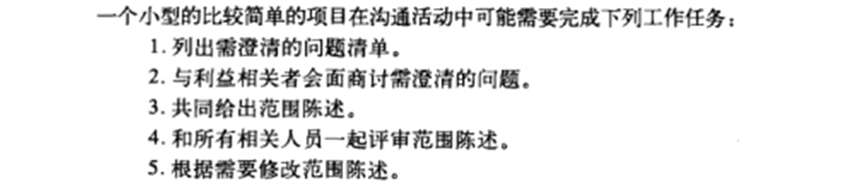
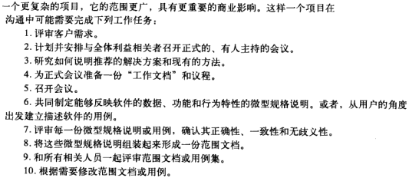
Process——过程分解
Notes:
----------------------------

Slide 22
Project
Projects get into trouble when …
  Software people don’t understand their customer’s needs.
  The product scope is poorly defined.
  Changes are managed poorly.
  The chosen technology changes.
  Business needs change [or are ill-defined].
  Deadlines are unrealistic.
  Users are resistant.
  Sponsorship is lost [or was never properly obtained].
  The project team lacks people with appropriate skills.
  Managers [and practitioners] avoid best practices and lessons learned.
Notes:
Project
----------------------------
项目正处于危险状态的信号 ，当……
软件人员不了解客户的需求。
产品范围定义得很糟糕。
没有很好地管理变更。
所选的技术发生了变化。
业务需求发生了变化 [或未能很好地定义]。
截止日期是不切实际的。
客户抵制。
失去赞助 [或从来没有真正得到过赞助]。
项目团队缺乏具有合适技能的人员。
管理者 [和开发人员] 没有很好地利用已学到的最佳实践和经验。

Slide 23
Project — the 90–90 rule
[Zah94]：
  The first 90 percent of a system absorbs 90 percent of the allotted effort and time. The last 10 percent takes another 90 percent of the allotted effort and time.
The seeds that lead to the 90–90 rule are contained
in the signs noted in the preceding list.
Notes:
Project——“90–90”规则
----------------------------
[Zah94]
系统前面90%的任务，会花费所分配总工作量和时间的90%
系统后面10%的任务，也会花费所分配总工作量和时间的90%
其根源就在于上述“信号”

Slide 24
Project —
Common-Sense Approach to Projects
Start on the right foot.
  This is accomplished by working hard (very hard) to understand the problem that is to be solved and then setting realistic objectives and expectations.
Maintain momentum.
  The project manager must provide incentives to keep turnover of personnel to an absolute minimum, the team should emphasize quality in every task it performs, and senior management should do everything possible to stay out of the team’s way.
Track progress.
  For a software project, progress is tracked as work products (e.g., models, source code, sets of test cases) are produced and approved (using formal technical reviews) as part of a quality assurance activity.
Make smart decisions.
  In essence, the decisions of the project manager and the software team should be to “keep it simple.”
Conduct a postmortem analysis.
  Establish a consistent mechanism for extracting lessons learned for each project.
Notes:
Project——易于理解的方法
----------------------------
如何避免上面提及的问题.........
在正确的基础上开始工作：首先努力(非常努力) 地正确理解要解决的问题，然后为每个参与项目的人员设置现实的目标和期望。
保持动力：为了维持动力，项目经理必须采取激励措施使人员变动量保持绝对最小，团队应该重视它完成的每项任务的质量，而高层管理应该尽可能不干涉团队的工作。
跟踪进展：对于软件项目而言，当工作产品 (如模型、源代码、测试用例集) 正在产生或被认可 (通过技术评审) 时，跟踪项目进展要作为质量保证活动的一部分。
做出英明的决策：总体上，项目经理和软件团队的决策应该 “保持项目的简单性”。
进行事后分析：建立统一的机制，从每个项目中获取可学习的经验。

Slide 25
W⁵HH Principle
To Get to the Essence of a Project …
Why is the system being developed?
What will be done?
When will it be accomplished?
Who is responsible?
Where are they organizationally located?
How will the job be done technically and managerially?
How much of each resource (e.g., people, software, tools, database) will be needed?
Notes:
W5HH原则
通过提出一系列问题，导出关键的项目特性以及项目计划的定义，描述项目的目标、里程碑与进度、责任、管理和技术方法以及需要的资源
为什么( Why) 要开发这个系统?
商业目的是否有效？为达目的是否值得花费这些人力、时间和金钱？
将要做什么(What)?
定义项目所需的任务集
什么时候(When)做?
制定项目进度，标识出何时开展项目任务以及何时到达里程碑。
某功能由谁(Who)负责?
规定软件团队每个成员的角色和责任
他们的机构组织位于何处(Where)?
并非所有角色和责任均属于软件团队，客户、用户和其他利益相关者也有责任
如何(How)完成技术工作和管理工作?
一旦确定了产品范围，就必须定义项目的管理策略和技术策略。
每种资源需要多少(how much) ?
(例如，人、软件、工具、数据库)? 通过估算得到

Slide 26
Critical Practices
Formal risk management
Empirical cost and schedule estimation
Metrics-based project management
Earned value tracking
Defect tracking against quality targets
People aware project management
Notes:
关键实践
----------------------------
正规的风险管理
成本及进度的经验估算
基于度量的项目管理
获得价值跟踪
根据质量目标跟踪缺陷
人员计划管理

